Slide 1
Teaching with a Tablet PC Using the Tablet in the Classroom
Bruce Yoshiwara
2012 Summer Engineering Teaching Institute
Los Angeles Pierce College
June 17-19, 2012

Slide 2
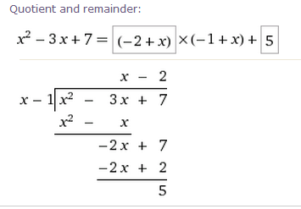
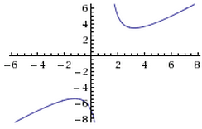
Markup and Freeform Drawing

Slide 3
Markup and Freeform Drawing
Paint (or other drawing program)
Word or PowerPoint: Review → Start Inking (old: Insert → Shapes → Lines → Scribble)
AcrobatPro: View → Comment → Drawing Markups →Draw free form
Office OneNote
Windows Journal
Math Input Panel (Start → All Programs →Accessories) or MS Equation Writer

Slide 4
Office OneNote
Choose pen for writing Tools → Writing Tools
… → Convert to text:
F11 to toggle between Full Page View and standard view.
(Aside: If you use multiple computers, you can keep notebooks in DropBox.)

Slide 5
Windows Journal
New document: Lined sheet
File → Page Setup → Style
Tools → Options → Note Format
View → Toolbars
Insert → Insert/Remove Space
Actions → Change Shape To

Slide 6
Insert Images
Insert → Insert Picture
Drag from TI Emulator
Copy and paste
Jing (or SnagIt, etc.) and paste
WolframAlpha
Google

Slide 7
Windows Journal: Print to Journal Note Writer

Slide 8
Print to Journal Note Writer (cont’d): Guided Notes
A linear equation (with two variables x and y) can be written in the form ax + by = c for some constants a, b, and c. The graph of such an equation is a .
An intercept is a point where the graph hits an axis. An x-intercept is on the x-axis, so it must have its y-coordinate equal to , and a y-intercept must have x .

Slide 9
Print to Journal Note Writer (cont’d)
To hide and reveal pre-prepared answer
Use black highlighter to hide
Use Stroke Eraser to remove
(To install Note Writer, open Journal, click on Tools → Install or Repair Journal Note Writer.)

Slide 10
Possibly Useful Free Utilities
Jing (to capture figures and text) from TechSmith: http://www.techsmith.com/
Pen Attention or Cursor Attention (so you can “point”): http://www.math.uaa.alaska.edu/~afkjm/PenAttention/download.html
Virtual Magnifier (so you can magnifiy part of your screen): http://magnifier.sourceforge.net/
Dropbox (synchronize and back-up across computers): http://db.tt/X8vxQHP
Fences (to clean up desktop): http://download.cnet.com/Fences/3000-2072_4-10909535.html

Slide 11
Tablet PC Alternatives
Standard swivel design (e.g. Lenovo)
Slate
External tablet
iPad

Slide 12
Poll
Did you know that MSWord includes a computer algebra system?

